Slide 1

PGCDS ASSIGNMENT #3
Post Graduate Certification in Data Science (PGCDS)
Applied Econometrics – assignment #3
TIME SERIES ANALYSIS - CO-INTEGRATION
GOLD and NIFTY 50 price series
Sonali A. Nimkar
Powered by:
March 2016
version 1.0

Slide 2
Background
The objective of this assignment is to perform co-integration analysis on the GOLD and NIFTY 50 price time series data
The data are tested for a con-integrating relationship using three methods:
1. Linear Modeling
2. VAR method
3. Granger causality testing

Slide 3
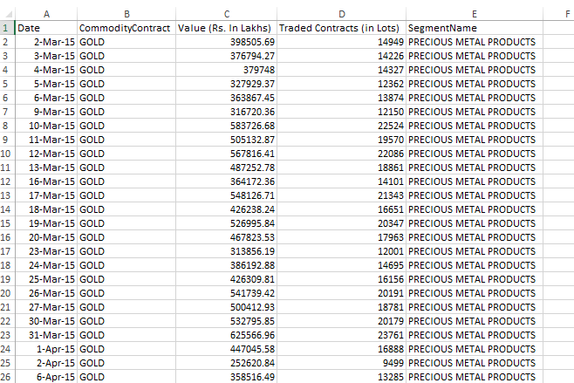
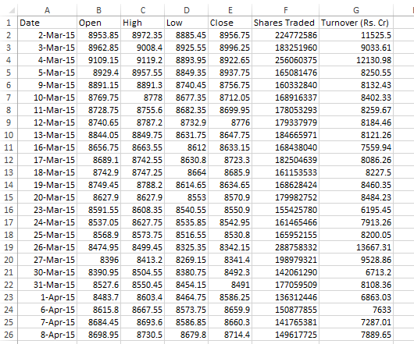
About the data …
Nifty50 prices are for the period from March 02, 2015 to February 29, 2016
Price data have been downloaded from investing.com
Gold prices are for the period from March 02, 2015 to February 29, 2016
Price data have been downloaded from investing.com
Some data points for Gold have been eliminated to align the two time series successfully.

Slide 4
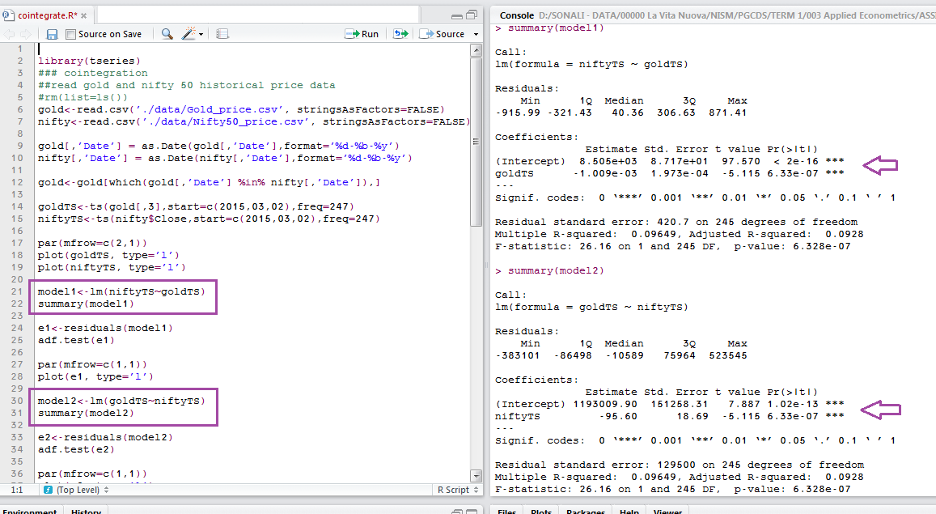

Slide 5
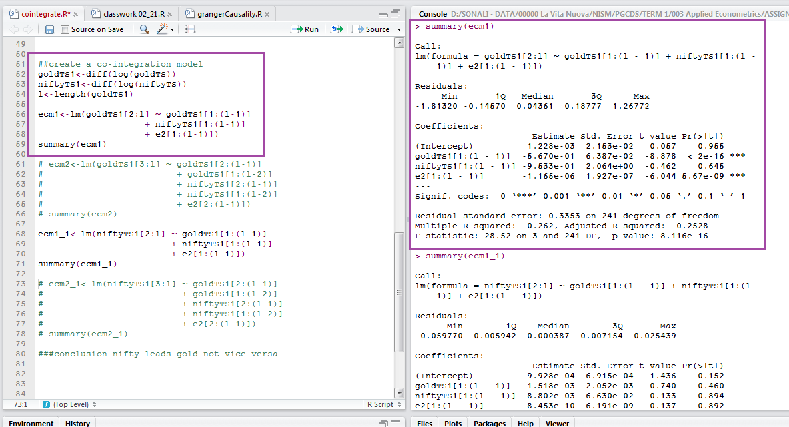

Slide 6
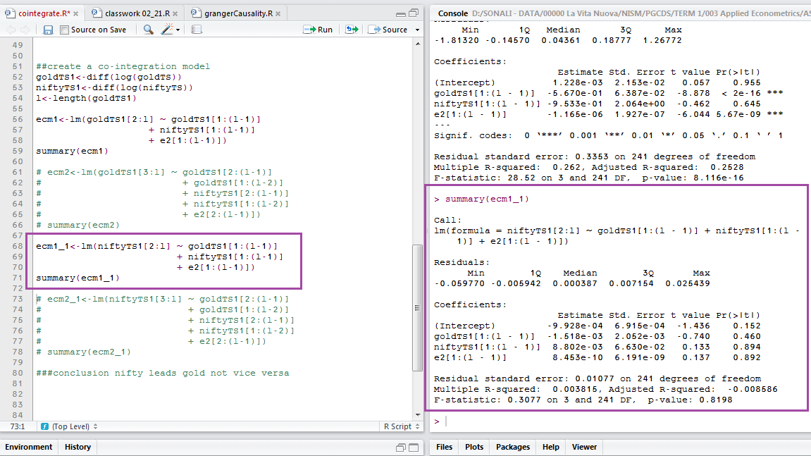

Slide 7
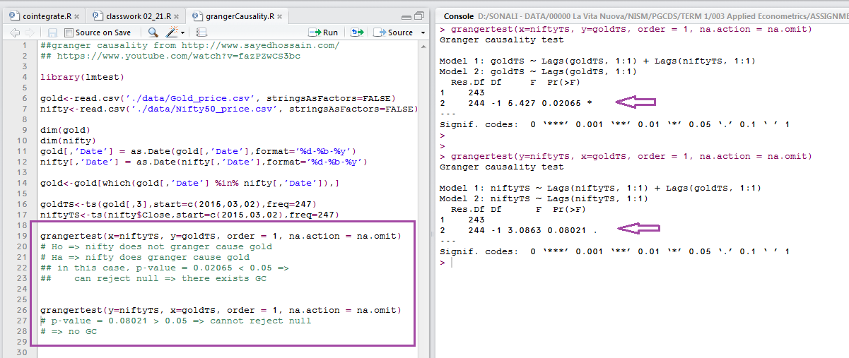
Granger Causality test

Slide 8
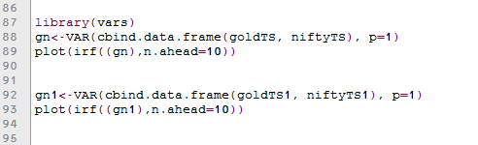
VAR Method
The VAR method is used on both the original and the differenced series
The impulse responses for both models are observed (as depicted in the following slides).
As expected, since the original series are not stationary – the impulse causes a permanent/ longer-term impact to the series
On the other hand, the differenced series are stationary – the impulse disturbs the series in the short-term only.

Slide 9
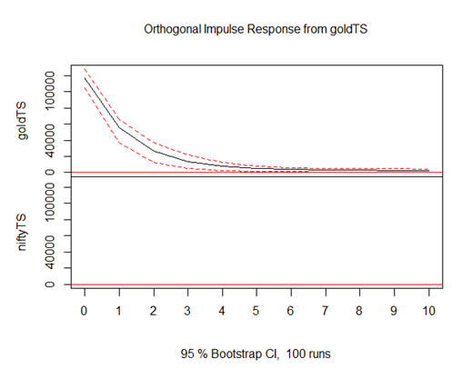
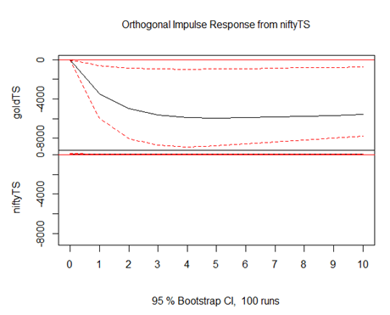
Impulse Response – original series

Slide 10
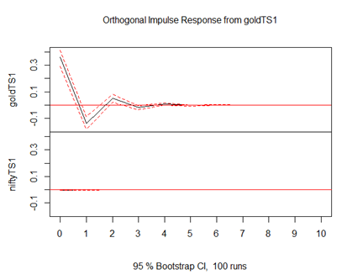
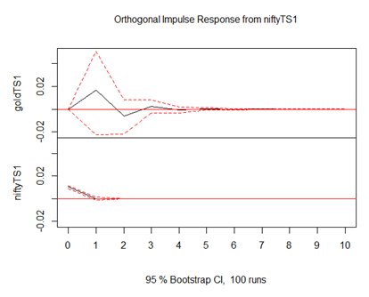
Impulse Response – differenced series

Slide 11
Conclusion
Nifty leads gold but not vice versa
Nifty and Gold time series are not stationary; their first differences, however, are stationary.

Slide 12
Thank you!

